Slide 1

Mobile sales analysis
2024/08/07
Shivam Bhatt

Slide 2

Introduction
Objectives
1.Analyze Market Trends:
Identify popular brands,models and features in the mobile market.
2.Customer Segmentation:
Classify customers based on demographics and purchasing behaviour.
3.Competitor Analysis:
Compare various mobile brands and models to understand competitive stregths
and weaknesses
4.Predict Future Trend:
Use predictive analytics to forecast future sales and consumer preferences.

Slide 3

DATA SOURCE
Source:
Imported from Kaggle Website.
Description:
Number of rows = 1001
Number of columns= 11

Slide 4




Programming Languages And Tools Used
1.Python.
Used for data cleaning ,analysis and visualization.
Libraries pandas matplotlib seaborn.
2.Sql.
Used for data extraction and database management.
Queries to retrieve filter and aggregate data.
3.Power Bi Tool
Used for creating interactive dashboards and reports.
Visualization of data trends and insights.
4.Excel
Used for preliminary data analysis and manipulation.
Functions pivot tables and basic visualizations

Slide 5

DATA PREPARATION
Data cleaning steps
1.Check for missing values:
Use isnull() to identify missing values
Example df.isnull().sum()
2.Handle missing values:
Drop rows with missing values using dropna().
Example df.dropna(inplace =True).
3.Check for duplicates:
Use duplicated() to identify duplicate rows.
Example df.duplicated().sum()
4.Remove duplicates rows:
Drop duplicates usinf drop_duplicates().
Example df.drop_duplicates(inplace=True)

Slide 6
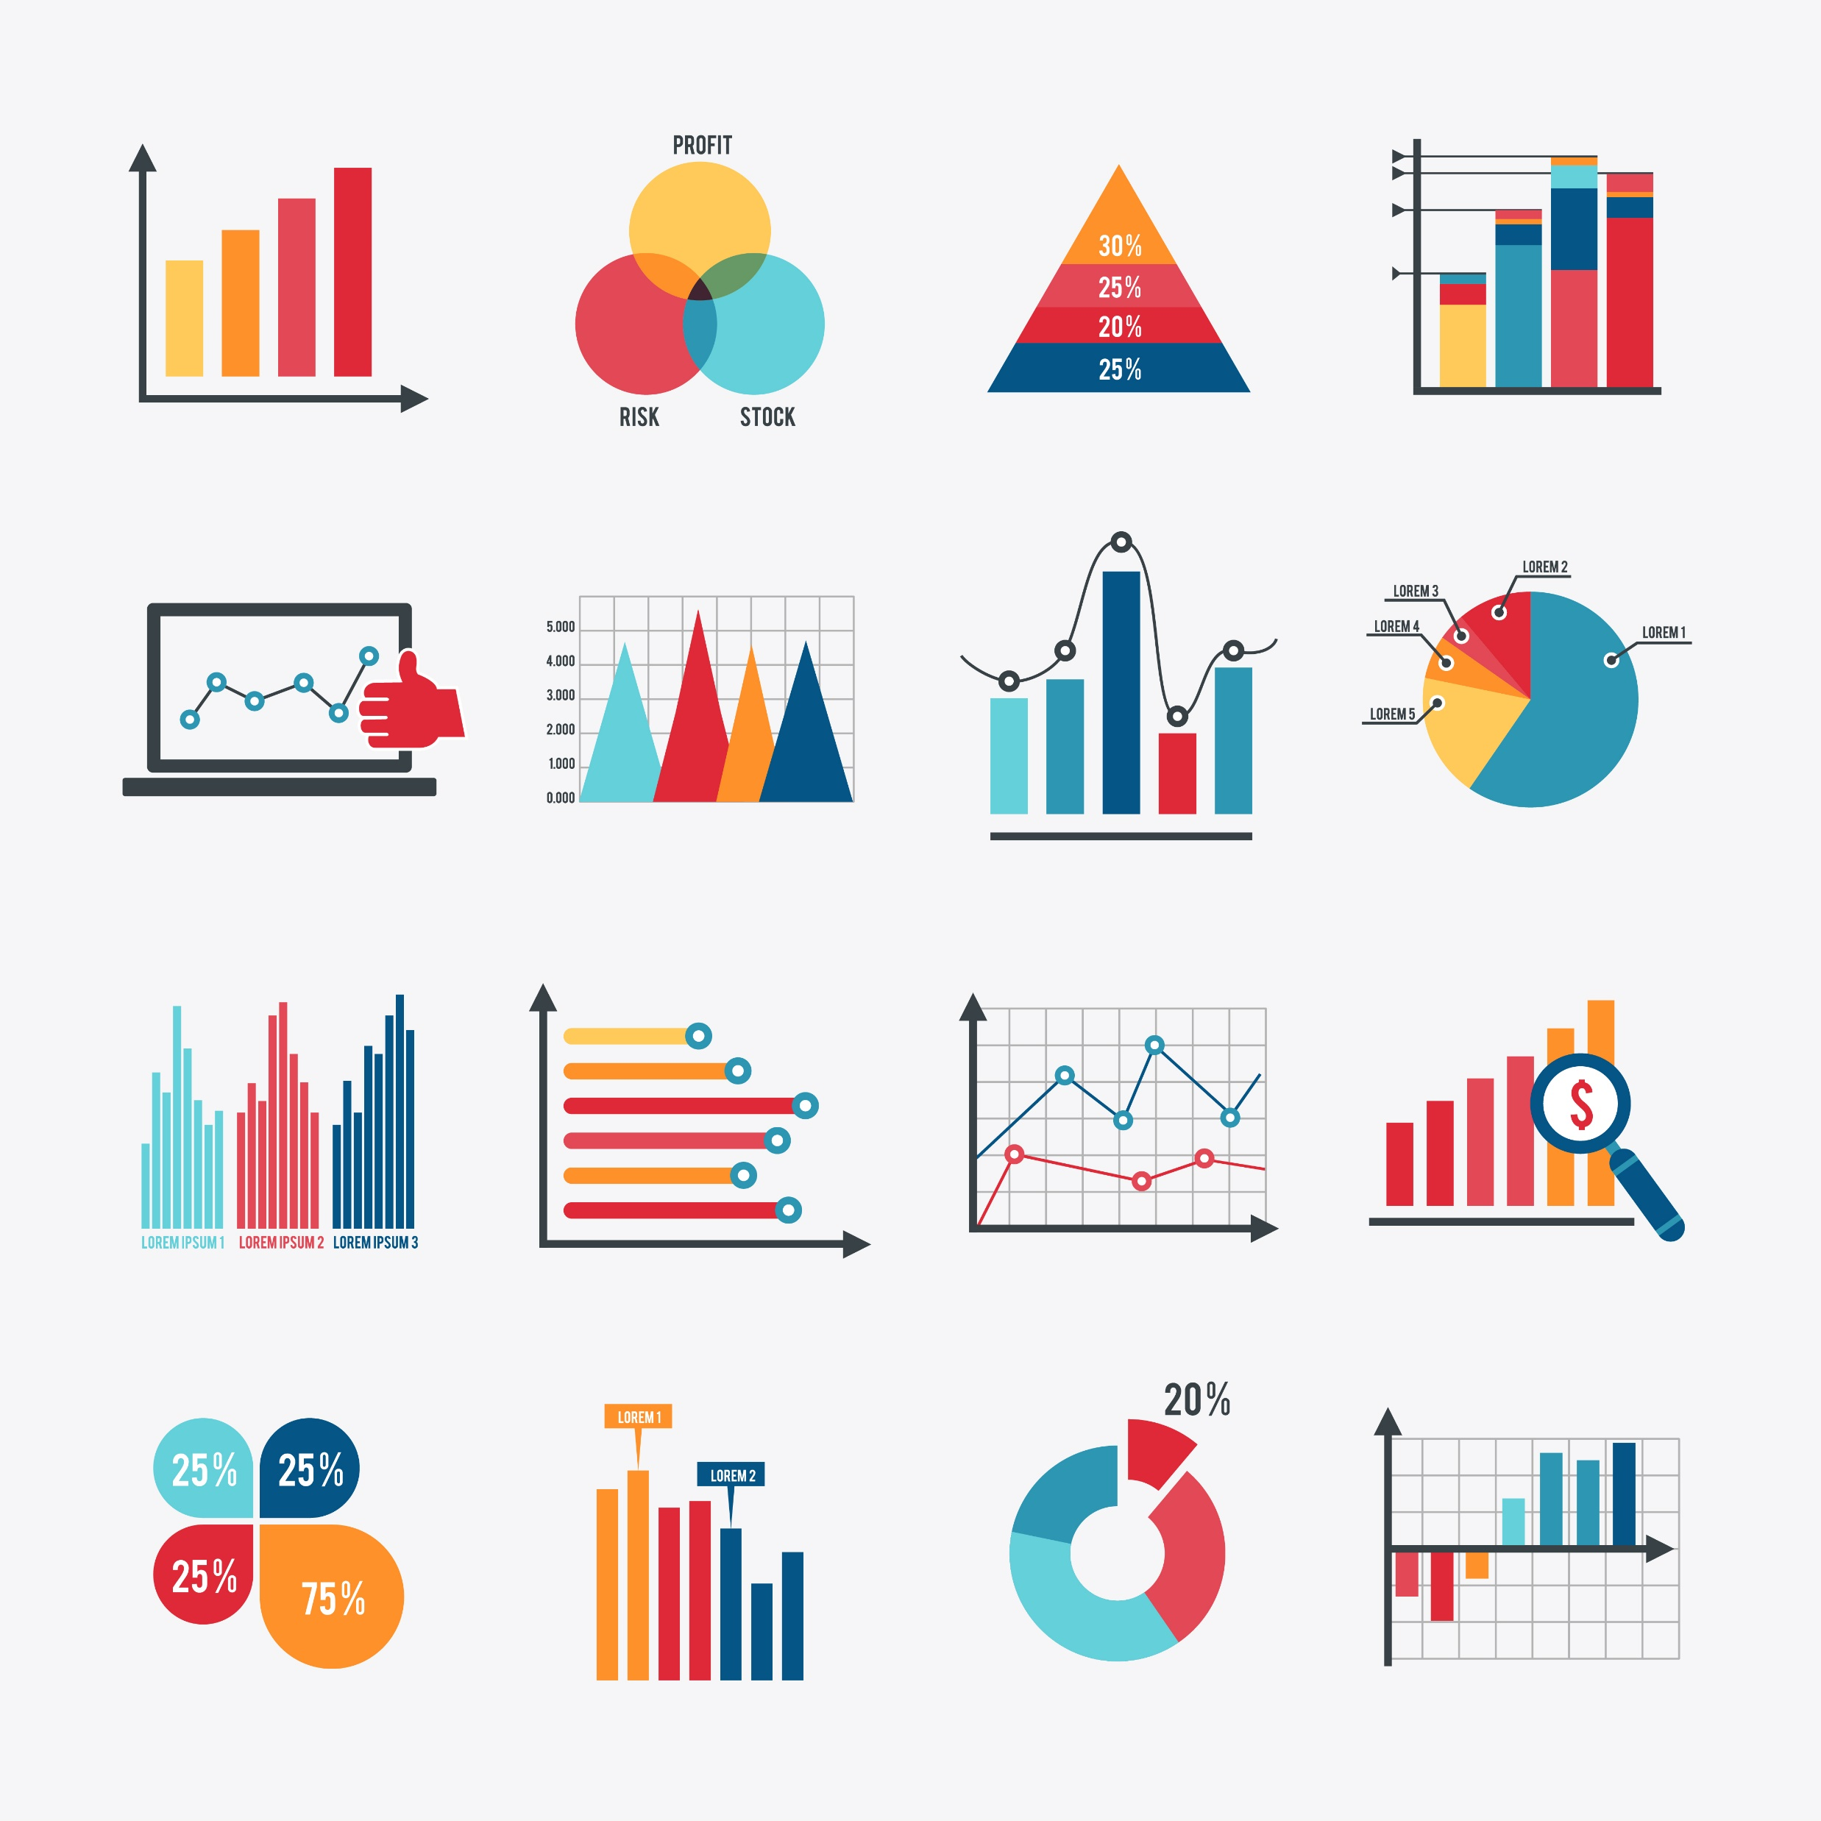
Key Metrics
The key performance indicators
1.Top 20 Average price per brands.
2.Payments methods as sum of units sold.
3.Top 20 brands as sum of units sold.
4.Gender as per units sold.
5.Months based per units sold
6.TOP 10 locations based total unit solds

Slide 7
TOP 20 AVERAGE PRICE PER BRANDS

Slide 8
PAYMENT METHODS AS PER UNITS SOLD

Slide 9
TOP 20 BRANDS AS SUM OF UNITS SOLD

Slide 10
GENDER AS TOTAL UNITS SOLD

Slide 11
MONTHS AS TOTAL UNITS SOLD

Slide 12
FUTURE WORK
Advanced Predictive Modeling: Develop and implement advanced predictive models using machine learning techniques to forecast future sales trends and customer behavior.Utilize time series analysis and regression models to predict seasonal variations and potential market shifts.
Sentiment Analysis:Incorporate sentiment analysis on customer reviews and social media data to understand customer perceptions and satisfaction levels.Analyze the impact of customer sentiment on sales and brand reputation.

Slide 13
CONCLUSION 1
The chart shows the sum of units sold for the top 20 brands. Here are some key observations:
Marquez Ltd sold the most units with a total of 199.
Cobb LLC follows closely with 179 units sold.
Harris and Sons and Ferrell Inc also have high sales with 157 and 173 units sold, respectively.
Most brands have units sold in the range of 99 to 133.
Brands like Willis, Watson and Monroe, Weaver Ltd, Wallace LLC, and Smith PLC have relatively lower sales compared to the top performers, with all having units sold around 99 to 132.

Slide 14
CONCLUSION 2
The chart shows the sum of units sold using different payment methods. Here are the key conclusions:
Credit Card is the most popular payment method, with 13,826 units sold.
Online payments are also popular, with 12,943 units sold.
Debit Card payments follow closely, with 12,648 units sold.
Cash is the least used payment method, with 10,657 units sold.
In conclusion, credit cards and online payment methods are the most frequently used for purchasing, while cash is the least preferred among the available payment options.

Slide 15
CONCLUSION 3
The chart shows the average price for the top 20 brands. Here are the key conclusions:
Mendoza, Delgado Ltd, and Jensen-Lowe have the highest average prices, all slightly above 1500.
Carroll, Brown and Calderon, Barry and have the lowest average prices, around 1460.
The average prices for most brands fall within the range of 1465 to 1495.
There is some variation in the average prices among the brands, but most of them are clustered around the 1470-1490 range.
In conclusion, there is a moderate range of average prices among the top 20 brands, with a few brands having higher prices around 1500 and a few having lower prices around 1460. Most brands have average prices in the middle of this range.

Slide 16
CONCLUSION 4
The pie chart represents the sum of units sold across different customer genders. Here are the specific values for each gender category:Female: 17,480 unitsMale: 15,457 unitsOther: 17,137 unitsConclusion:Female Customers: Female customers have purchased the highest number of units (17,480), indicating they may be the most significant customer segment in terms of unit sales.Male Customers: Male customers have purchased 15,457 units, making them the smallest segment among the three.Other Gender: Customers categorized as "Other" have purchased 17,137 units, which is very close to the number of units purchased by female customers.

Slide 17
CONCLUSION 5
Michaelhaven: This location has the highest number of units sold, with 216 units, making it the most significant contributor to sales among the top 10 locations.Walkerborough: The second-highest location in terms of units sold is Walkerborough, with 169 units.Port Paulstad and West Lisa: These two locations follow, with 140 and 139 units sold, respectively.Other Locations: The remaining locations have sales figures that range from 122 to 130 units sold.

Slide 18
CONCLUSION 6
Seasonal Trends:The visualization shows the total units sold per month from January to July.January has the highest sales with 7818 units sold, indicating a potential peak season or post-holiday sales spike.
Sales Fluctuations:There is a noticeable drop in sales in February with 6729 units, suggesting a post-peak decline.Sales recover in March and April with 7380 and 7697 units sold, respectively.
Mid-Year Decline:A decline in sales is observed from May (7268 units) to July (6373 units).June and July have the lowest sales figures after February, indicating possible seasonal or market-related factors affecting sales.
Consistent Patterns:Despite fluctuations, sales figures remain relatively high throughout the first half of the year, with a minimum of over 6300 units sold each month.

Slide 19

THANK YOU
SHIVAM BHATT

